Slide 1
Using Ensemble As an ESB
Presentation Subtitle

Slide 2
Enterprise Service Bus（ESB） 架构
将服务提供者与消费者隔绝
消费者
Enterprise Service Bus
提供者

Slide 3
Enterprise Service Bus (ESB)架构
可供消费者使用的服务
消费者
Enterprise Service Bus
提供者

Slide 4
Enterprise Service Bus(ESB) 架构
外部服务仅对服务总线可见
消费者
Enterprise Service Bus
提供者

Slide 5
基础架构

Slide 6
Services Available to Consumers
Public Service Registry

Slide 7
Ensemble Public Service Registry
Ensemble暴露的服务列表
可用于搜索服务以及服务详细内容
Location and URL
Simple values or documents
Descriptions
Service Level agreement
Custom information
使用REST API
基于Resource的访问控制
提供Ensemble管理员界面进行管理服务注册

Slide 8
Public Service Registry
保存的信息包括
Name
Domain
Version
Lifecycle Stage (actual property name is just Stage) - Concept, Development, Test, Staging, Live, Deprecated, Defunct
Service Protocol - SOAP, REST, HTTP, File, etc…
Description
Endpoint
Response Style - Sync, Callback, Remote Deposit, None
Topics (as a list)
….

Slide 9
REST API
消费者可查询到注册信息
一共9个函数，例如 …
GetAbount
Path: /about
Lists the public API REST calls that are available
GetServices
Path: /services
Returns all services that have been marked as visible and which this particular use is permitted to see (both of these conditions are needed for the other methods as well)
GetServicesByID
Path: /services/id/:name/:domain/:version
Returns the particular services which can be identified by these three properties
GetServicesByProtocols
Path: /services/protocols/:protocols
Returns services whose protocols are among those in the comma-delimited list of specified protocols

Slide 10
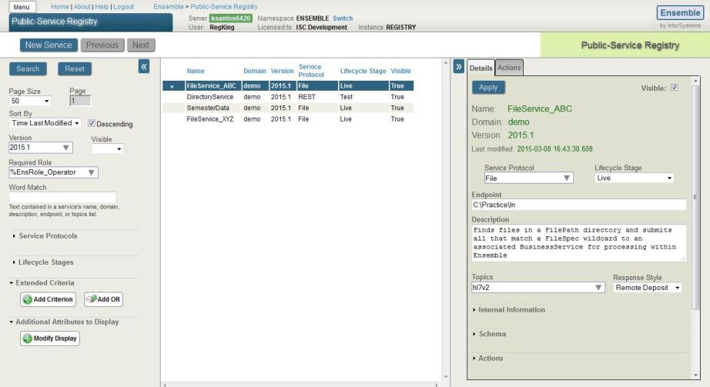
管理界面
创建、更新、删除

Slide 11
实现步骤
添加%EnsRole_RegistryManager role
进入注册页面管理公共服务注册
创建Web Application，Dispatch Class: Ens.ServiceRegistry.API.REST.Query
http://localhost:57772/registry/services
http://localhost:57772/csp/docbook/DocBook.UI.Page.cls?KEY=EESB_configure#EESB_web_app_registry

Slide 12
Services that can be called from Ensemble
External Service Registry

Slide 13
Enterprise Service Bus Architecture
管理接入Ensemble的服务
Consumers
Enterprise Service Bus
Providers

Slide 14
External Registry
关注于Ensemble调用的服务
主要用于设置下面组件的属性
EnsLib.FTP.InboundAdapter
EnsLib.FTP.OutboundAdapter
EnsLib.File.InboundAdapter
EnsLib.File.OutboundAdapter
EnsLib.HTTP.OutboundAdapter
EnsLib.SOAP.OutboundAdapter
EnsLib.SQL.InboundAdapter
EnsLib.SQL.OutboundAdapter
EnsLib.TCP.OutboundAdapter
每个组件不同的Endpoint含义
http://localhost:57772/csp/docbook/DocBook.UI.Page.cls?KEY=EESB_configure#EESB_servop_extreg

Slide 15
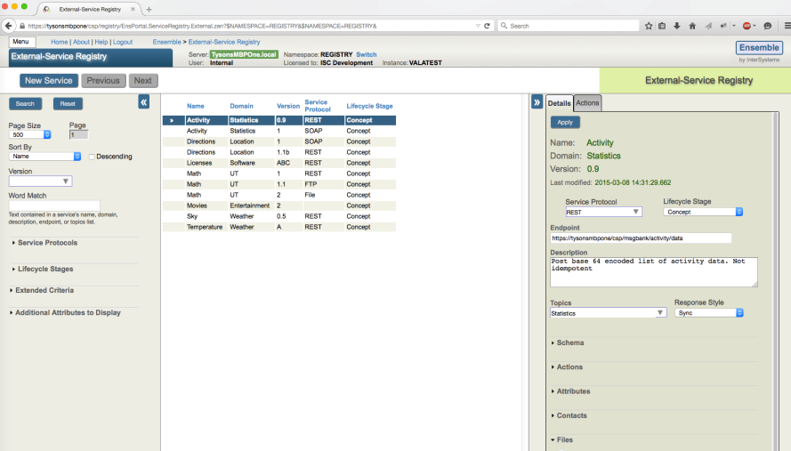
External Service Registry
Administrator User Interface

Slide 16
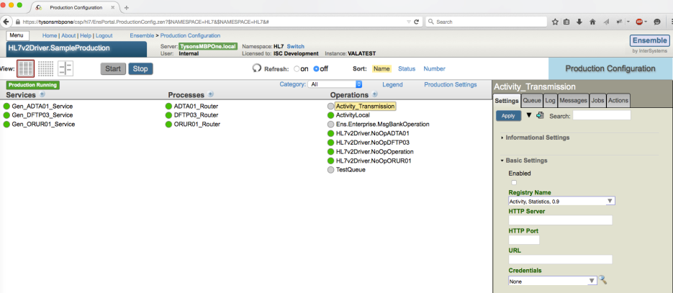
External Service Registry
Configuration Screens

Slide 17
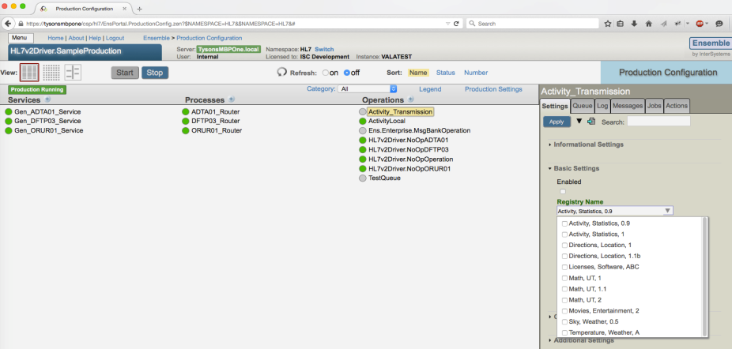
External Service Registry
Configuration Screens

Slide 18
相关参数

Slide 19
共有字段
Name
Version
Domain
Lifecycle Stage
Service Protocol
Endpoint
Topics
Schema
Type
Reference
Notes
Thumbnail
Content
Actions
Attributes
Contacts
Files
http://localhost:57772/csp/docbook/DocBook.UI.Page.cls?KEY=EESB_registry_admin#EESB_registry_fields

Slide 20
Internal Fields in the Public Service Registry
Public
Required Roles
Instance
Namespace
Production
ConfigName
http://localhost:57772/csp/docbook/DocBook.UI.Page.cls?KEY=EESB_registry_admin#EESB_registry_fields_internal

Slide 21
作为中间件消息传送
Pass-Through服务与操作

Slide 22
Pass-Through 服务
用于传递服务请求
原始请求：
http://api.openweathermap.org/data/2.5/weather?q=London,uk
通过Ensemble提供服务的请求
http://localhost:57772/Restpassthrough/WeatherRESTPassthroughServ/data/2.5/weather?q=Boston,ma
请求组成
http://localhost:nnnnnn/
web-application-name/
passthrough-service-name/
原外部需要的URL，比如 data/2.5/weather?q=London,uk.
添加下面服务类：
EnsLib.HTTP.GenericService
EnsLib.REST.GenericService
EnsLib.REST.SAMLGenericService
EnsLib.SOAP.GenericService
EnsLib.SOAP.SAMLGenericService
添加下面操作类：
EnsLib.HTTP.GenericOperation
EnsLib.REST.GenericOperation
EnsLib.SOAP.GenericOperation

Slide 23
创建非持久化消息的Pass-Through服务
添加下面操作类
EnsLib.HTTP.GenericOperationInProc
EnsLib.REST.GenericOperationInProc
EnsLib.SOAP.GenericOperationInProc
在相应的BS中设置
Persist Messages Sent InProc 为不选状态

Slide 24
Pass-Through服务与操作

Slide 25
监控Pass-Through服务与操作
Activity Volume And Duration
用途
追踪整理系统性能
保证系统符合服务端合约 Service-Level Agreements (SLAs).
发现潜在的问题
记录
在固定周期内（10秒）总完成的消息数量
处理这些消息的总用时

Slide 26
监控的实现过程
添加Ens.Activity.Operation.Local 到ensemble 运行的production BO下
配置监控收集数据所在的命名空间
激活该BO
指定监控项目
EnableStatsForProduction()
do ##class(Ens.Util.Statistics).EnableStatsForProduction()
EnableStatsForConfig()
在web application中设定使用Deepsee

